Slide 1

Amr live

Slide 2




Antimicrobial resistance

Slide 3
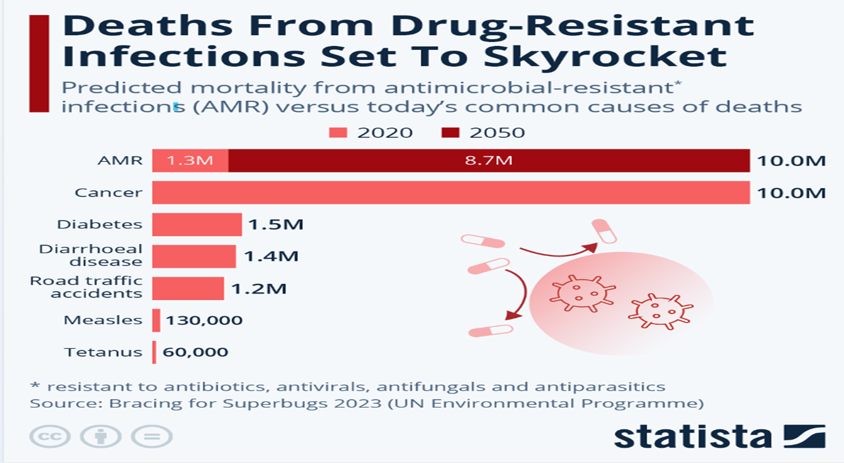
CONSEQUENCES OF AMR

Slide 4
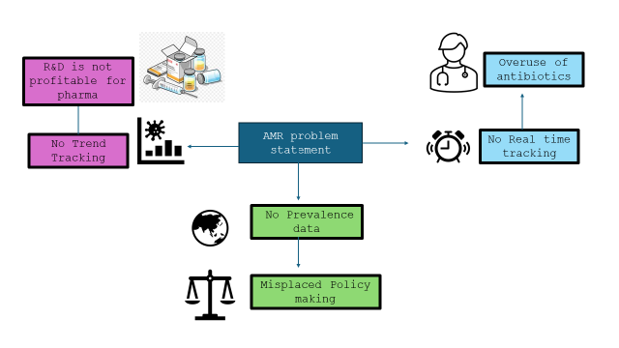
Problem statement

Slide 5


PROBLEM STATEMENT
HEALTH INNOVATION
Bacterial AMR was directly responsible for 1.27 million global deaths in 2019 and contributed to 4.95 million deaths
Given the dynamic nature of AMR, stakeholders including policymakers, healthcare professionals, and pharmaceutical companies face challenges in actively monitoring trends for informed decision-making in real time.

Slide 6
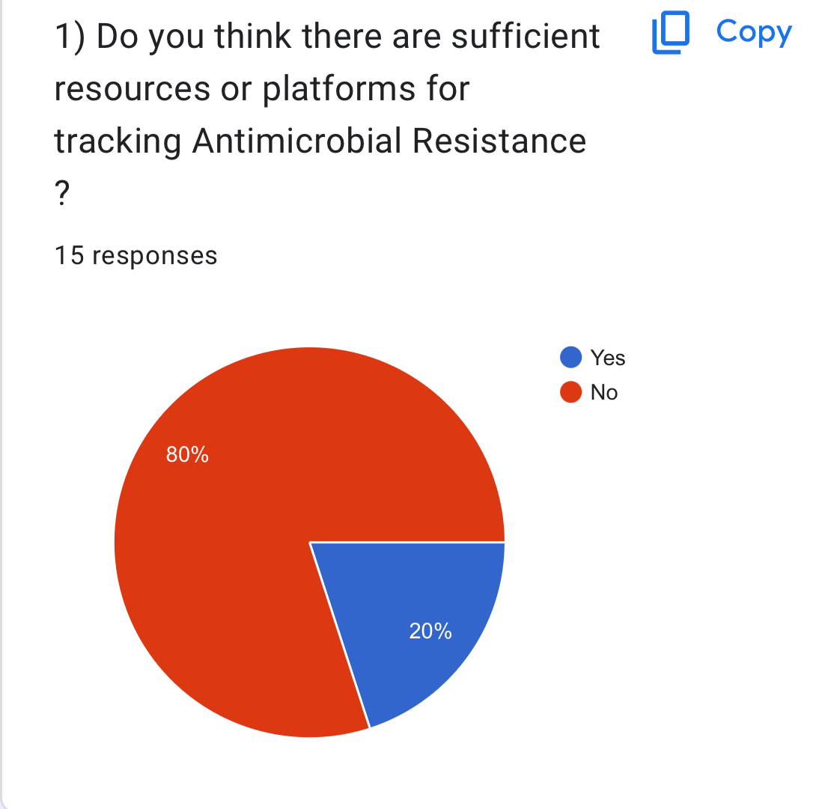
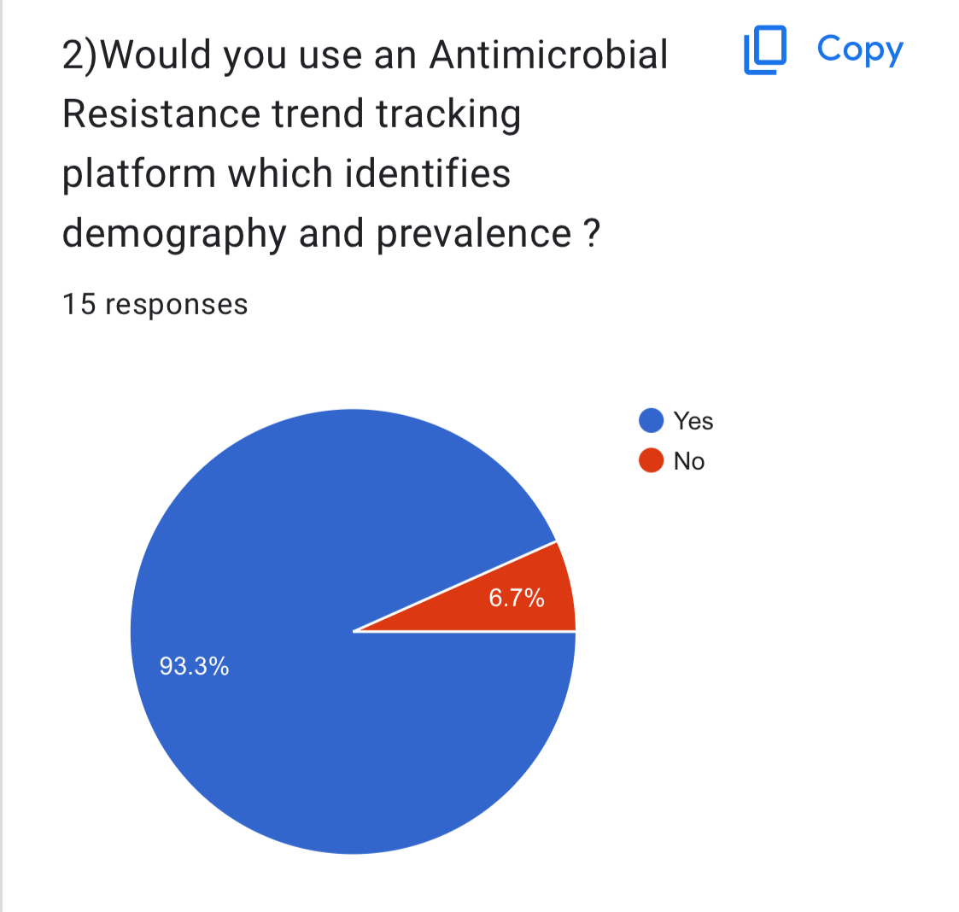
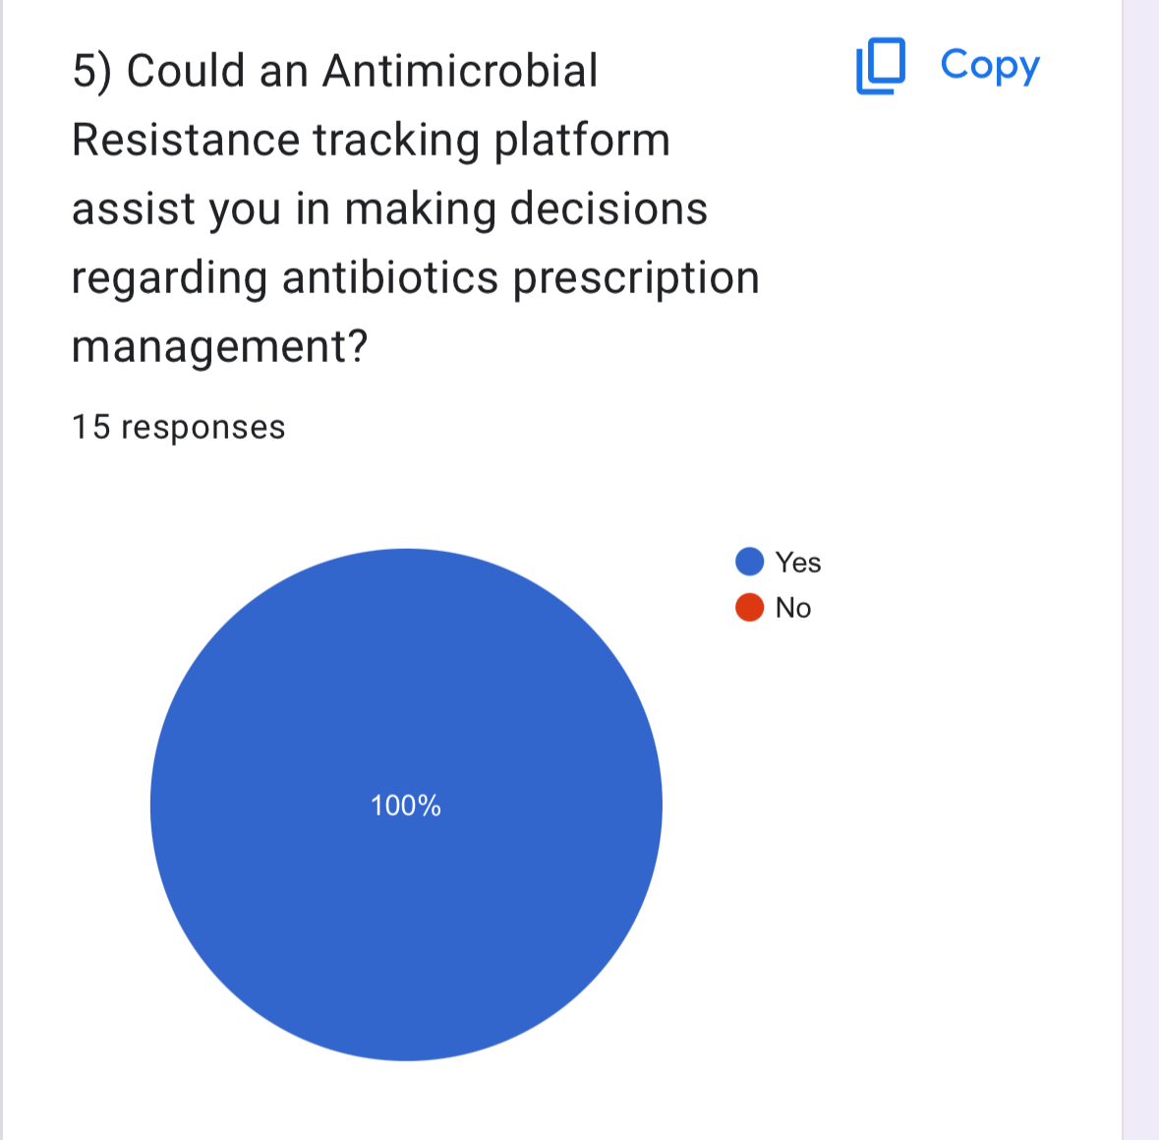
Market Survey

Slide 7

solution
Introducing AMR Live, a cutting-edge system designed to track AMR trends through extensive text mining of diverse publications.
This innovative approach enables the identification of trending drugs, bacterial species, and affected countries, providing crucial insights for timely decision-making

Slide 8
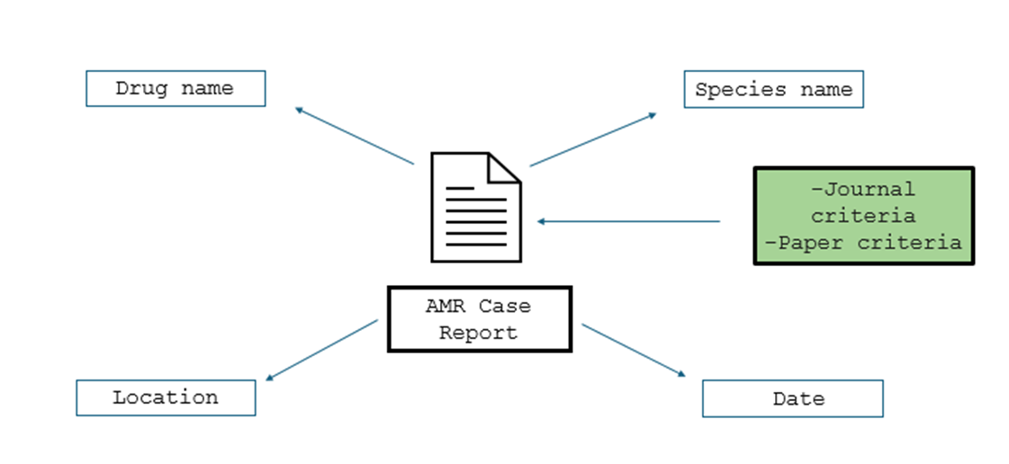
Technology behind amr live
REAL-TIME DATA COLLECTION
AI INTEGRATED INTERFACE

Slide 9
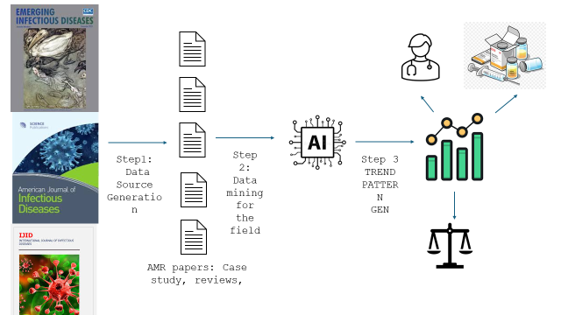

Slide 10
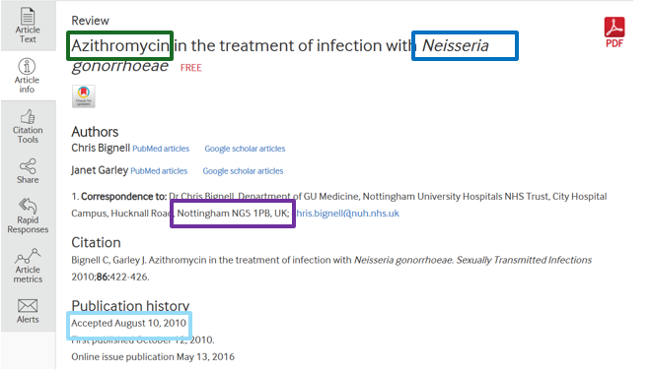
Dynamic data collection our usp

Slide 11
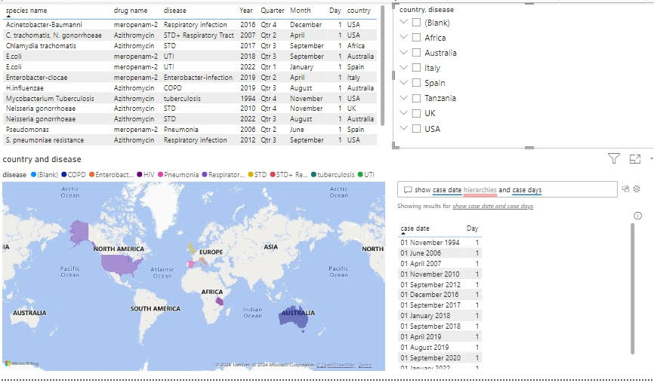
AI INTEGRATED USER INTERFACE

Slide 12
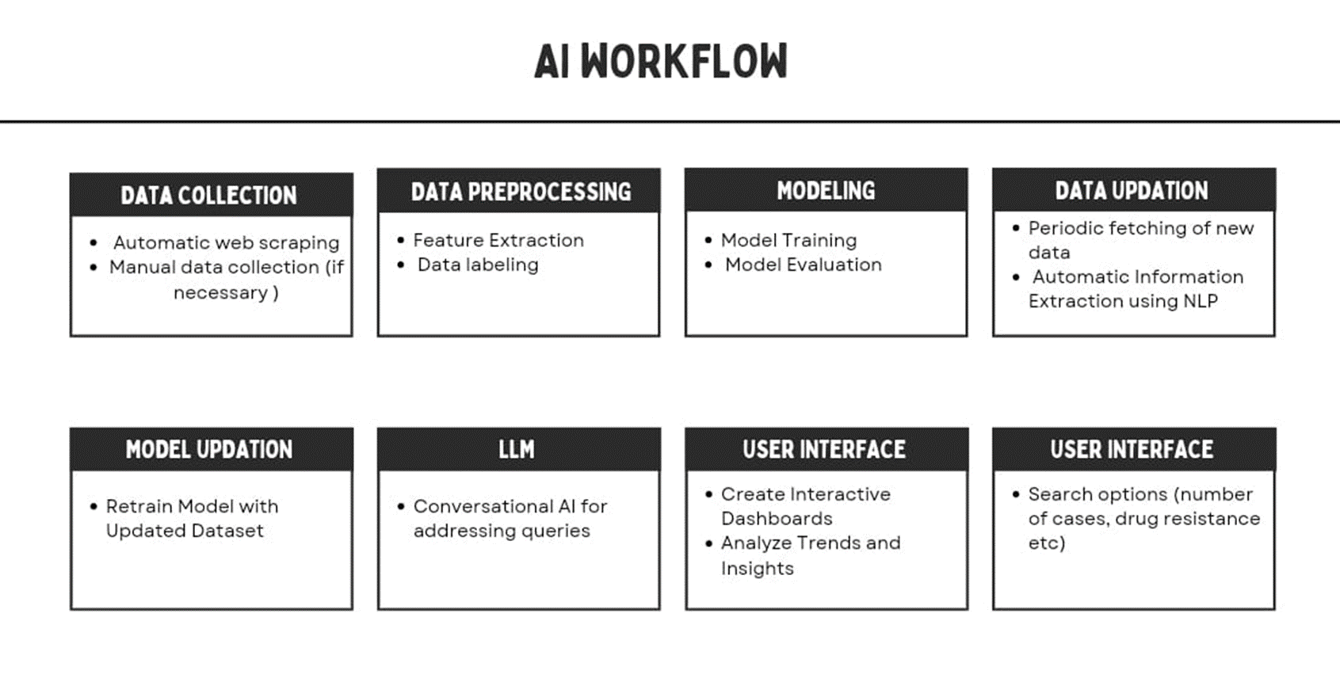
TOOLS USED FOR AMR LIVE

Slide 13
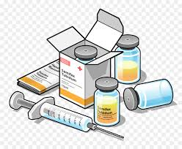





Easy Prescription management
Smart R&D for Pharma industry
AMR Live Features
Trend Tracking
Real time tracking
Prevalence
Efficient drug procurement by health authorities

Slide 14
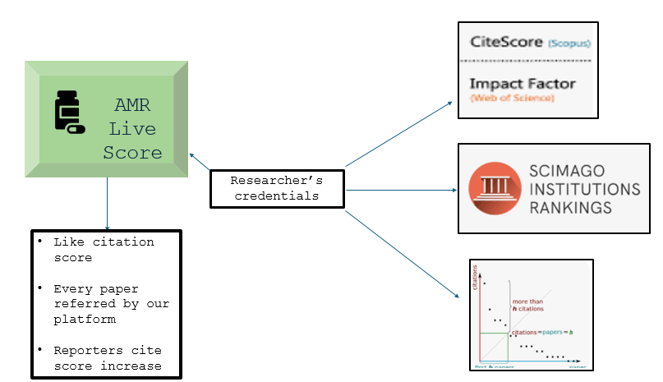
Marketing plan

Slide 15
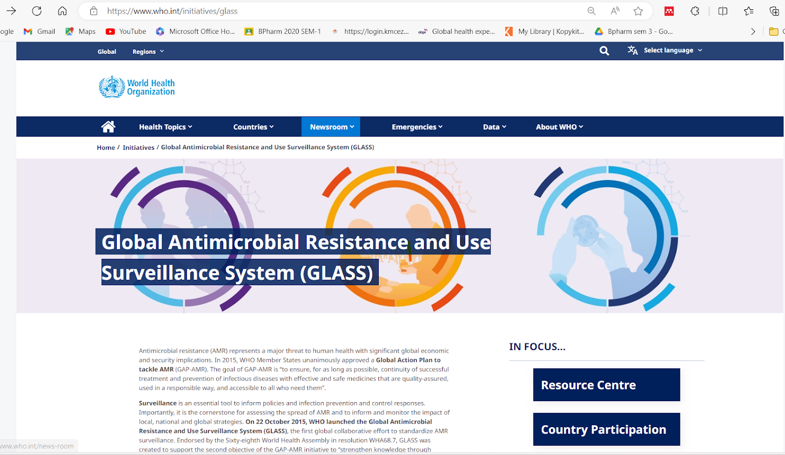
Competitor analysis-WHO Global Antimicrobial Resistance and Use Surveillance System (GLASS) (who.int)
 | AMR Live | WHO GLASS
Data timeline | Dynamic real time data | Data only available till 2020
Disease/drug coverage | Broad coverage as per requirement | Restricted to 4 categories
Country coverage | Broad coverage as per requirement | AMR data on the dashboard for USA is not published
Finances | Less expensive- Development cost | Very expensive- requires on ground resources

Slide 16
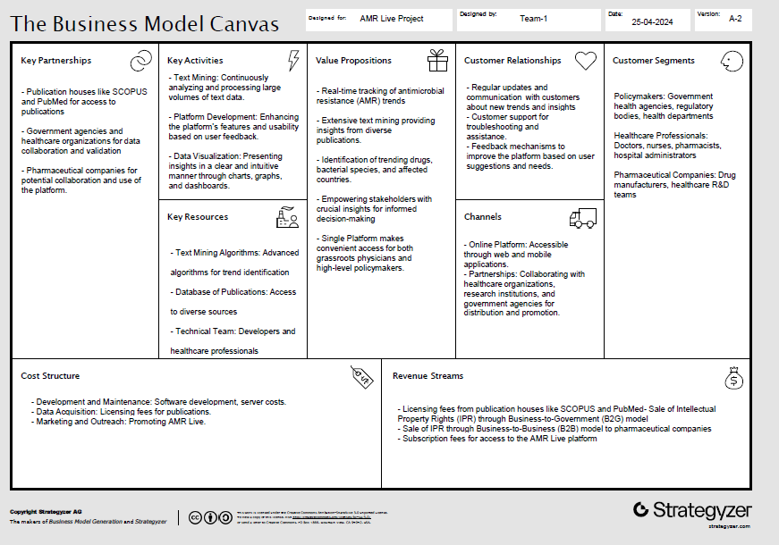

Slide 17
AMR live-Social Innovation
 | Benefits for the collaborators | Benefits for AMR live
Pharma industry | Market Insights Collaboration Custom Reports Early Warnings | Research Partnerships anonymized data for drug development. Brand Reputation
Publishing house | They gain exposure through your initiative, and you gain valuable data. Credit publishing houses in your reports and publications. Provide insights back to publishers (e.g., trends they might have missed). | Data Access Partnership: Establish formal agreements with publishing houses to access their extensive databases. Mutual Benefit: Emphasize how their data contributes to a critical cause (AMR awareness) and aligns with their mission
Gov. Body | Policy Alignment: Evidence-Based Policies: Position AMR Live as a resource for informed policy decisions. Collaborate on Guidelines: | Public Health Impact: Showcase how AMR Live contributes to national health goals. Data Sharing: Governments can contribute anonymized data for a broader view. Advocacy: Governments can advocate for AMR awareness using your insights.

Slide 18
Ask :
Resources | Estimated Cost involved
Technology and Coding members: Developers Data collection System and Data validation | $50,000
Medicine and Health members | $20,000
Infrastructure such as computers etc (if required) | $15,000
Total | $85,000

Slide 19



KEY TIMELINE GOALS
MILESTONE
REAL TIME IMPLEMENTATION
Planning on collaboration with scientific publishing houses/pharma industry/government
Optimizing UI by understanding user feedback- pilot scale model
Building our Dynamic data collection method
W1
W2
W3
W4
W1
W2
W3
W4
W1
W2
W3
W4
W1
W2
W3
W4
May
June
July
August

Slide 20





THE TEAM
Shivapranav
Yashas
Saif
Industry, Gov, Pharma Relations Head
CEO
CTO – Health Care
Sai Disha
Naresh Babu
CTO - Engineering
CFO

Slide 21
Thank you ☺
TEAM MEMBERS

